Slide 1
IF-Defense: 3D Adversarial Point Cloud Defense via Implicit Function based Restoration
Ziyi Wu¹*, Yueqi Duan²*, He Wang², Qingnan Fan², Leo Guibas²
¹Tsinghua University ²Stanford University
2020.12.15

Slide 2
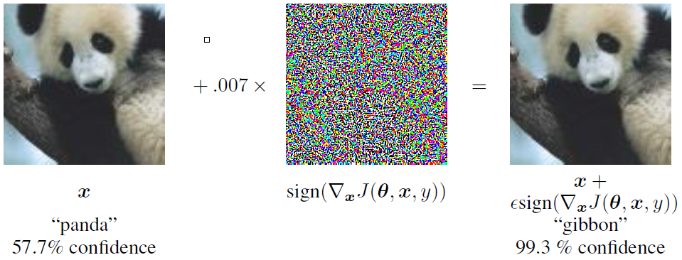
Adversarial Machine Learning (Adv ML)
What?
Adv example: fool the victim model while being visually similar to clean data
Why? (ECCV’20 Adv Workshop)
Security: defend against an adversary
Robustness: test the worst-case robustness of ML systems
Interpretability: towards human-level abilities
How?
Two settings: white-/black-box attack
White-box: gradient ascent
Black-box: query+search
[1] Carlini, Nicholas, et al. "On evaluating adversarial robustness." arXiv preprint arXiv:1902.06705 (2019).
[2] Goodfellow, Ian J., Jonathon Shlens, and Christian Szegedy. "Explaining and harnessing adversarial examples." ICLR 2015.
Notes:
OK so let’s start with adversarial machine learning. Although deep neural networks have achieved super-human performance in many tasks, previous works show that, by adding some well-designed but imperceptible noises to the input data, the networks will predict wrong answers with high confidence. And this kind of examples are called adv examples. The adv attack and defense studies how to generate and defend against such examples. They form the fundamental problems of adv ML.
So why this topic is so important? Here I quote from a talk in this year’s ECCV workshop on adv robustness, which answers this question in three folds. First, adversarial defense can protect ML systems from potential adversary and ensure their security. Secondly, adversarial robustness is believed to be the worst-case robustness of a model, which holds the lower bound of the performance it will achieve under some perturbations or noises. Thirdly, we can interpret some abnormal behaviors of deep networks using theories from adv ML, thus measuring the progress of ML algorithms towards human-level abilities.
And here I’d like to briefly introduce how to perform adv attacks. Basically there are two settings of attack, namely white-box and black-box. For white-box attack, the attackers know the architecture and weight of the victim models, so they can simply use gradient ascent. Take the classification task for example, we input this image x to the model, compute the cross-entropy loss J and the gradient of J w.r.t. x. Then we multiply the gradient with a factor \alpha and add it to x and repeat this process for several times until getting a wrong prediction. This is simply gradient ascent right. Besides, for black-box attack, the attackers have no knowledge about the victim models. So they can only query the model by modify the input and observe the output prediction. Then use some searching methods like binary search or evolution algorithm to get the optimal solution. Overall, adv ML is a widely studied topic in the 2D image domain.

Slide 3
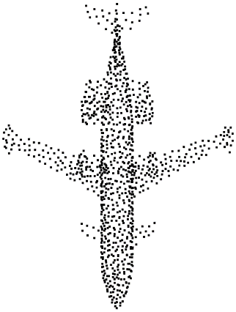
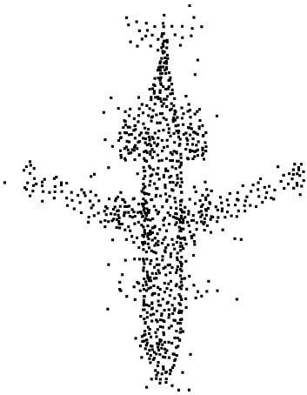
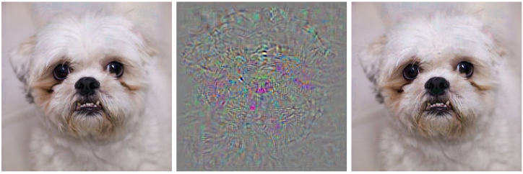
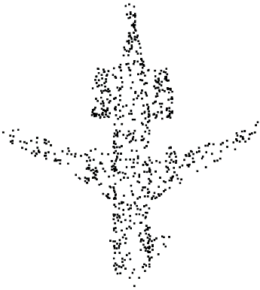
Adv ML in 3D Point Clouds
Why?
Safety-critical applications, e.g. self-driving cars
Occlusions, noises, sparsity in raw point clouds
3D and 2D attacks are different!
2D attacks can only change pixel values
3D attacks can perturb point coordinates, add or drop some points
Point clouds are unstructured and unordered
[1] Goodfellow, Ian J., Jonathon Shlens, and Christian Szegedy. "Explaining and harnessing adversarial examples." ICLR 2015.
[2] Xiang, Chong, Charles R. Qi, and Bo Li. "Generating 3d adversarial point clouds." CVPR 2019.
Notes:
Good, as numerous algorithms are proposed for 2D attack and defense, why we need to study them in 3D point clouds? First, as the direct output of 3D sensors such as LiDAR and RGB-D scan, point clouds are used in many safety-critical applications like self-driving cars and robotics, and we need to ensure their security. Secondly, raw point clouds obtained by sensors naturally have occlusion, noise and sparsity issues, so adv defense can improve point cloud networks’ robustness against these problems. Moreover, 3D attacks are quite different from their 2D counterparts. While 2D attacks change each pixel’s value, 3D attacks can not only perturb point coordinates, but also change the number of points by adding or dropping. This is because point clouds are unstructured data, while images have regular grid structures.
Therefore, we think point cloud adv ML is not just a simple extension from 2D, we hope to identify and tackle those 3D-specific issues.

Slide 4
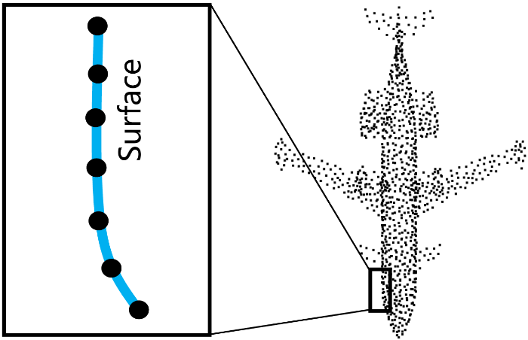
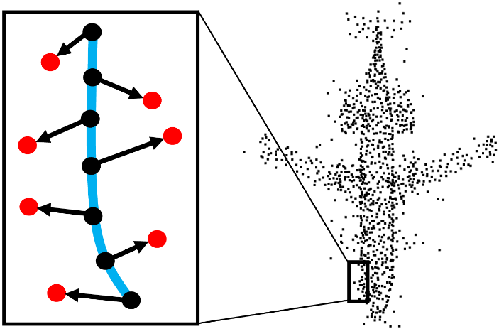
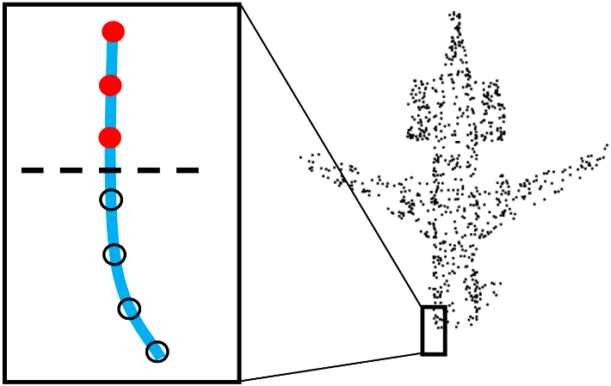
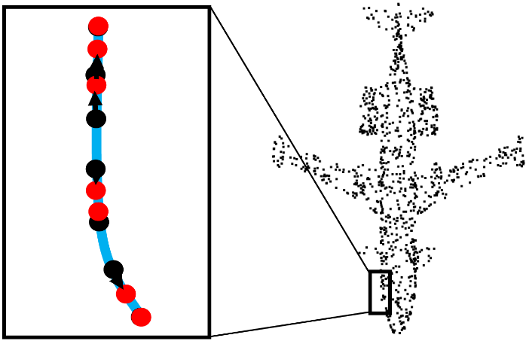
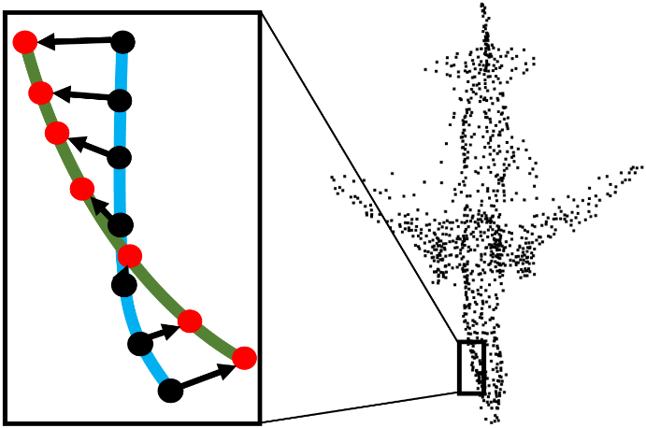
Different Attack Effects
clean
Point perturbation
Out-of-surface perturbation
On-surface perturbation
Surface distortion
Local part removal
Geometric Deformation
(a) out-of-surf. pert.
(c) Part Removal
(b) on-surf. pert.
(d) Geo. Deformation
Notes:
So back to our work, in IF-Defense, we first review existing point cloud attacks and summarize their attack effects into 2 aspects from a geometric perspective. Here are their visualizations. This is a clean airplane, the black points are uniformly sampled from its blue object surface.
For point perturbation, the out-of-surface perturbation perturbed the points off the surface to become outliers, which is similar to noise. This is on-surface perturbation, where the points are still on the blue curve, but they become randomly distributed. Just compare the entire airplanes, the clean one is like FPS and the adv one is similar to random sampling. The change of sampling pattern also degrades the accuracy according to our experiments because the features become less discriminative.
For surface distortion, the local part removal drops the head and the tile of the airplane, which might be caused by occlusions in real world. And geometric deformation distorts the object’s normal shape. The deformed airplane is like an out-of-distribution (o.o.d.) example which is bound to be misclassified because it’s never seen during model training.
Overall, the point perturbation effect is small, local changes, while the surface distortion effect changes the global geometry of an object. They are harder to defend but easier to perceive.

Slide 5
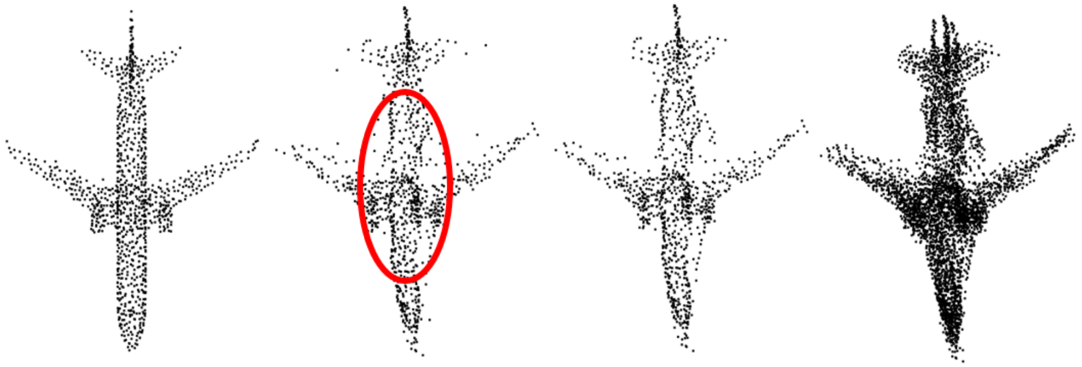
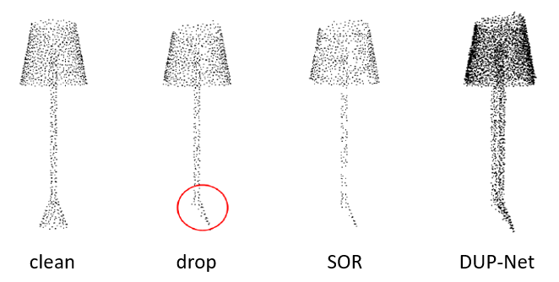
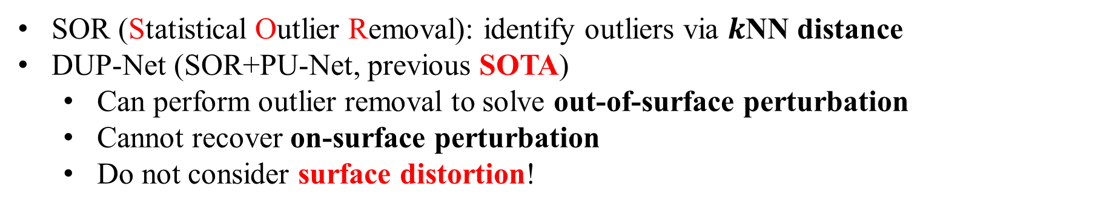
Existing Defenses
SOR (Statistical Outlier Removal): identify outliers via $k$NN distance
DUP-Net (SOR+PU-Net, previous SOTA)
Can perform outlier removal to solve out-of-surface perturbation
Cannot recover on-surface perturbation
Do not consider surface distortion!
clean
adv
SOR
DUP-Net
clean
adv
SOR
DUP-Net
[1] Zhou, Hang, et al. "DUP-Net: Denoiser and upsampler network for 3D adversarial point clouds defense." ICCV 2019.
Notes:
And we also review existing defenses. So far there are only two published methods, namely SOR and DUP-Net. SOR stands for statistical outlier removal, it calculates the kNN distance for each point and discard points that are far from their neighborhoods. And DUP-Net consists of a SOR preprocessor and a point cloud upsampling network called PU-Net. It claims to recover uniform point distribution via upsampling.
In our preliminary experiments, we discovered that SOR is truly useful for outlier removal. It can greatly alleviate the out-of-surface perturbation. However, DUP-Net’s performance against on-surface perturbation is unsatisfactory, as the output airplane here has very messy point distribution. In addition, none of them considers surface distortion! Here is an example of local part removal, where part of lamp’s base is dropped. SOR just discards more points, and PU-Net only upsamples points which are near the input points. As a result, they can’t recover the complete base of the lamp.

Slide 6
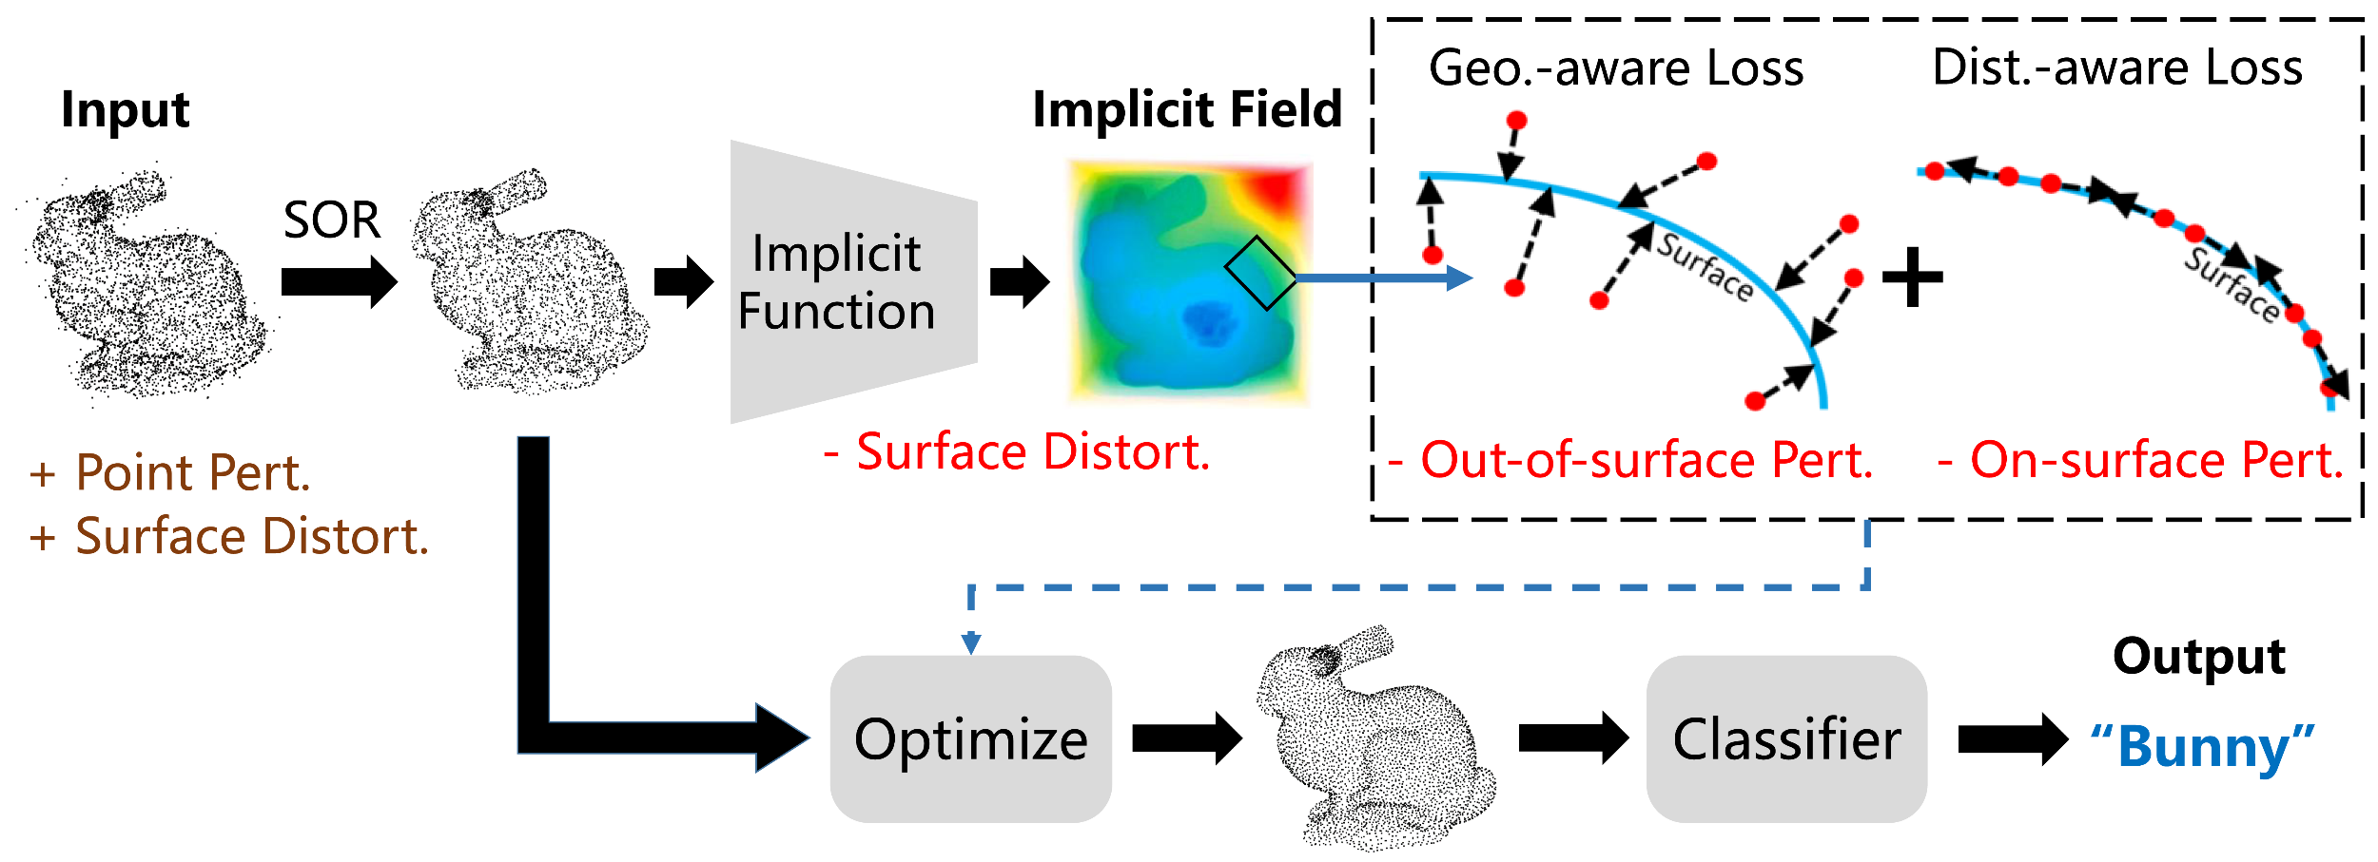
IF-Defense: Implicit Function based Restoration
Two key steps of our defense:
Surface recovery: recover the natural shape, via an implicit function network
Point cloud restoration: re-generate points from implicit fields of shapes, via an optimization-based process
Notes:
So in our work, we aim at proposing a defense framework that can simultaneously address both the attack effects. And we propose to do so in two key steps, namely surface recovery and point cloud restoration. I will talk about them in detail later. But first let’s have a look at the pipeline of our IF-Defense. Given an adv point cloud as input, we first apply SOR to remove obvious outliers. Then in the surface recovery step, we employ an implicit function network to recover the natural shape of the object. And in the point cloud restoration step, we adopt an optimization-based process to re-generate points from the implicit field guided by two loss.

Slide 7
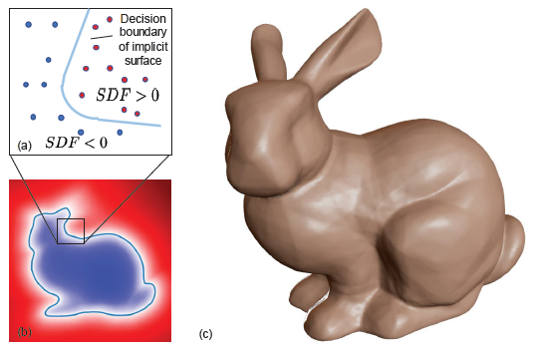
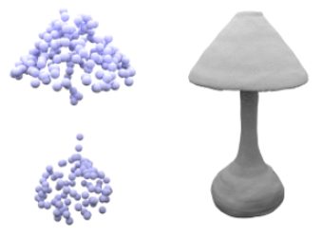
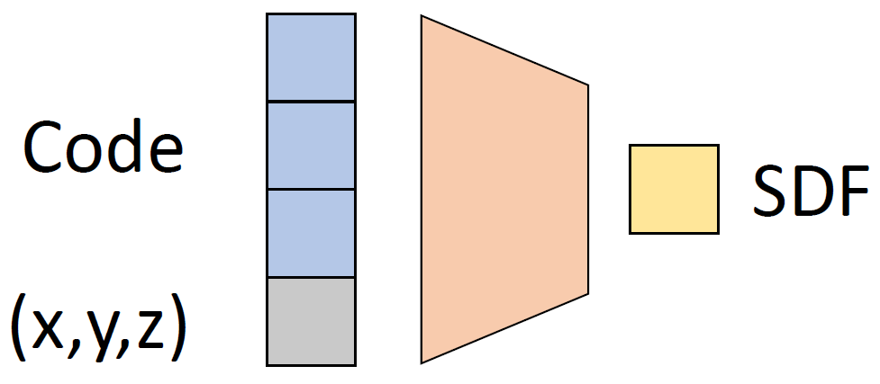
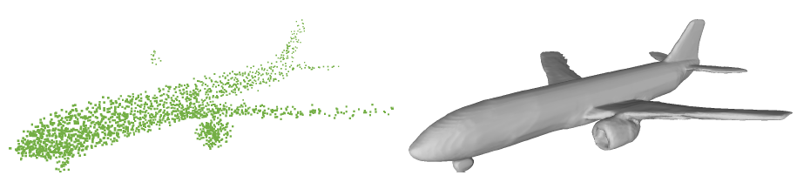
Surface Recovery
Implicit function (IF) network: trained on clean shapes in the reconstruction task
Encode shape priors: natural shape completion & recovery
Input the adv point cloud to an IF, get an implicit representation of the natural shape
DeepSDF
Occupancy Network
[1] Park, Jeong Joon, et al. "Deepsdf: Learning continuous signed distance functions for shape representation." CVPR 2019.
[2] Mescheder, Lars, et al. "Occupancy networks: Learning 3d reconstruction in function space." CVPR 2019.
Notes:
For the surface recovery step, let me first introduce implicit function. It is a family of functions that map a coordinate to a scalar according to the object shape. Suppose this is a rabbit and its 2D projection. For signed distance function (SDF), it will output positive values for positions out of the object boundary, and negative for inner positions. And for occupancy field, which is another type of implicit function, it outputs 1 for inner points because they’re occupied by the object, and 0 for outer points. In a word, the implicit functions represent object surface as their zeroth level-set. More recently, implicit function networks leverage deep neural networks to approximate such mappings. They first use an encoder to extract features or the so-called shape code from the input, whether it’s an image or a point cloud. And the decoder takes in a 3D coordinate (x, y, z), conditioned on the shape code, predicts the SDF or occupancy value at that position. You can regard it as a query function over the entire 3D space conditioned on the shape code.
So the implicit functions have many good properties. They are locally smooth thus free of noise, and can represent arbitrary complex geometry. More importantly, if we train an implicit function network to reconstruct clean shapes, they will encode shape priors in the model. In other words, they can project the input shapes back to the clean shape manifold. Previous works have leveraged this property to perform shape completion, DeepSDF can reconstruct the entire airplane from the partially observed point cloud, and Occupancy Network is able to connect the head and the base of this lamp that are originally separated. So we input the adv point cloud to a pretrained implicit function network, and get an implicit representation of the recovered shape.

Slide 8
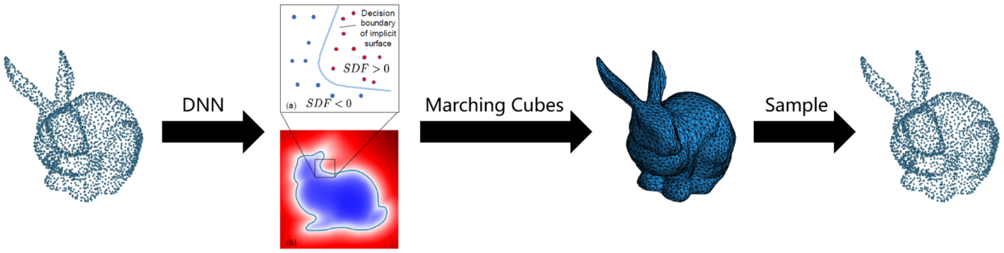
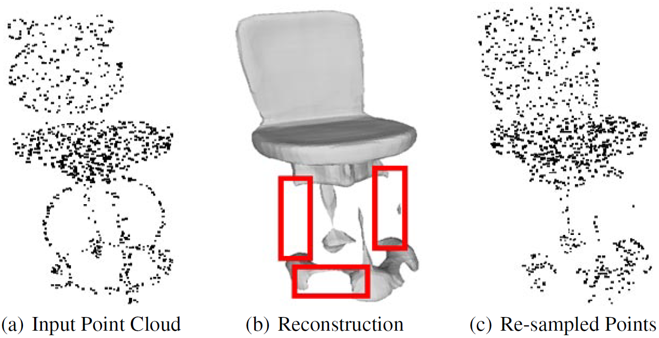
Point Cloud Restoration
How to re-generate a point cloud from the implicit representation?
An intuitive way: re-mesh & re-sample
Errors in the implicit field degrade the defense performance!
[1] Park, Jeong Joon, et al. "Deepsdf: Learning continuous signed distance functions for shape representation." CVPR 2019.
[2] Duan, Yueqi, et al. "Curriculum DeepSDF." ECCV 2020.
Notes:
OK so now the next step is to re-generate a point cloud from the implicit field of the shape as the defense result. An intuitive way is to first use Marching Cubes algorithm to reconstruct a mesh, and then sample a point cloud from it, where we are able to control the sampling pattern. However, Marching Cubes completely replies on the predicted implicit field, which may contain certain errors. We know that even SOTA method can’t achieve 100% reconstruction accuracy, let alone here the input point cloud is adversarial and may have noise. For example here, the ONet fails to reconstruct the legs of the chair, and the re-sampled point cloud is misclassified.

Slide 9
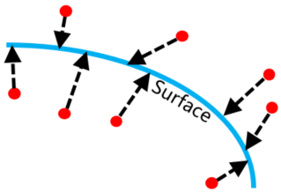
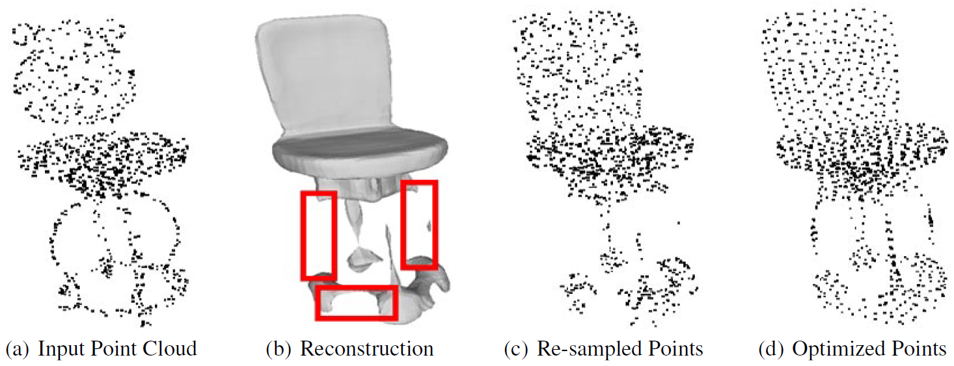
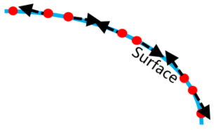
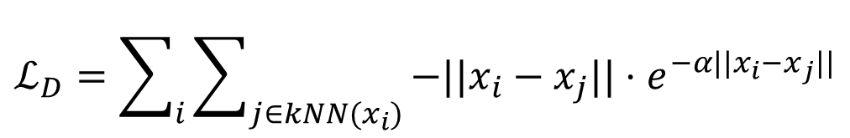
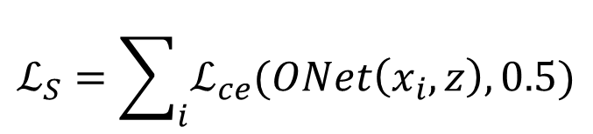
Optimization-based Restoration
0.5
Input points lying on missing parts, can compensate the errors in implicit field!
Initialize from input points, optimize their coordinates according to:
Geometry-aware loss: capture the surface
Distribution-aware loss: uniform distribution
Geo-aware loss
$$ℒ_{S}=\sum_{i}{ℒ_{ce}(ONet\left(x_{i}, z\right),0.5)}$$
Dist-aware loss
$$ℒ_{D}=\sum_{i}{\sum_{j∈kNN(x_{i})}{−||x_{i}−x_{j}||⋅e^{−α||x_{i}−x_{j}||}}}$$
Notes:
This is motivates us to propose an alternative way for restoration. Let’s have a closer look at the failure case, there are actually large number of points lying on the missing part, and we want to utilize them to compensate the reconstruction errors. Concretely, we directly initialize a point cloud from input points, and optimize their coordinates according to two loss.
The geometry-aware loss aims to capture the object surface. Suppose I adopt the Occupancy Network or ONet as the implicit function. Suppose this is the object boundary modeled by ONet, which outputs 0.5 for the surface. We input the red points which are the points to be optimized to ONet and get their predicted occupancy probabilities. Then we compute cross-entropy loss with GT equals to 0.5. So what’s the result of minimizing this loss? For points initialized near the surface, they will be pushed towards the boundary. But for points initialized at the missing part of the implicit field, the loss provides no gradient because ONet outputs nearly the same values among these regions. After all they’re considered not occupied so the occupancy values are all close to 0. It’s like doing gradient descent on a loss plateau, the points get stuck there and remain to form the missing parts.
The distribution-aware loss is straightforward, we maximize the distance between a point x_i to its kNN x_j, where the exponential term is a scaling factor that punishes greater for closer points. This loss leads to a uniform point distribution. This is the optimization result of the chair, where the legs are successfully retained and points are uniformly distributed. Consequently, it’s correctly classified by the victim model.

Slide 10
Experiments
ModelNet40 classification task
Victim models: PointNet, PointNet++, DGCNN, PointConv and RS-CNN
Implicit function network: ONet and ConvONet
Attacks evaluated:
Point perturbation – CVPR’19
Point adding – CVPR’19
kNN attack – AAAI’20
Point dropping – ICCV’19
LG-GAN – CVPR’20
AdvPC – ECCV’20
Defenses evaluated:
SOR
DUP-Net (previous SOTA)
SOR+PointNet AutoEncoder (SOR-AE)
Re-meshing based IF-Defense w/ ONet (Mesh)
Optimization based IF-Defense w/ ONet or ConvONet (Opt or Conv-Opt)
Out-of-surface perturbation
On-surface perturbation
Local part removal
Geometric deformation
[1] Peng, Songyou, et al. "Convolutional occupancy networks." ECCV 2020.
Notes:
Now time for experiments. We test our IF-Defense comprehensively on the MN40 shape classification benchmark. We adopted five victim models, PN PN++ and DGCNN are classic models, and we select PointConv and RS-CNN because they are among the recently popular convolution based models, whose robustness haven’t been tested in previous works. For the implicit function networks, we employ Occupancy Network (ONet) and Convolutional Occupancy Network (ConvONet). ConvONet is an improved version of ONet with stronger reconstruction capacity.
We evaluate several baseline point cloud attacks. Generally speaking, the point perturbation and adding attack mainly cause outliers by out-of-surface perturbation, the kNN and AdvPC attack change point distribution by on-surface perturbation and the point dropping and LG-GAN attack result in local part removal and geometric deformation respectively. For defense methods, we evaluate SOR, DUP-Net, SOR followed by a PointNet AutoEncoder termed SOR-AE, and three variants of our IF-Defense. Mesh means the re-meshing based IF-Defense with ONet as the implicit function. Opt and Conv-Opt stand for the optimization based IF-Defense with ONet and ConvONet respectively.

Slide 11
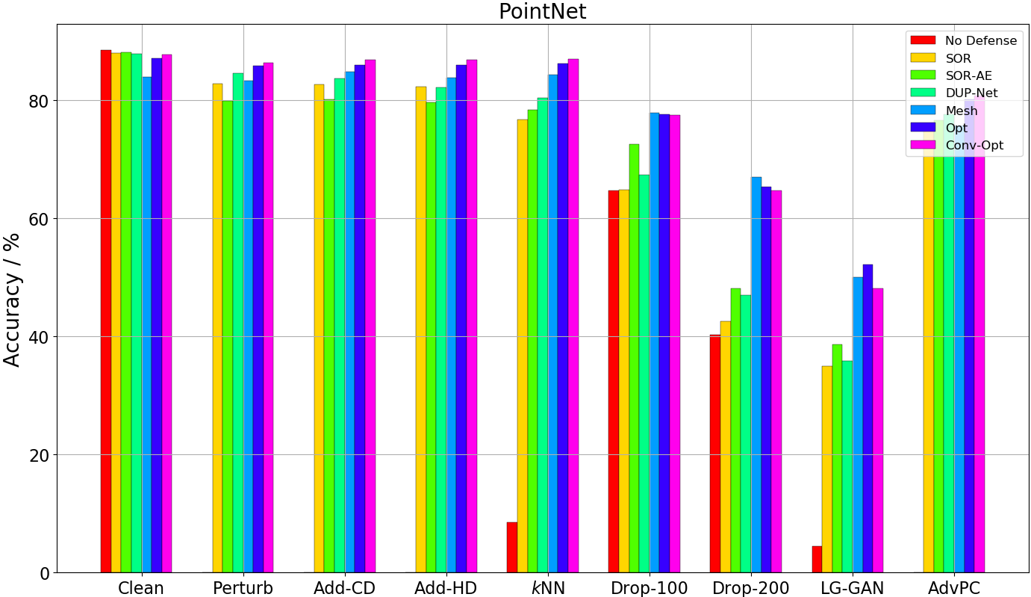
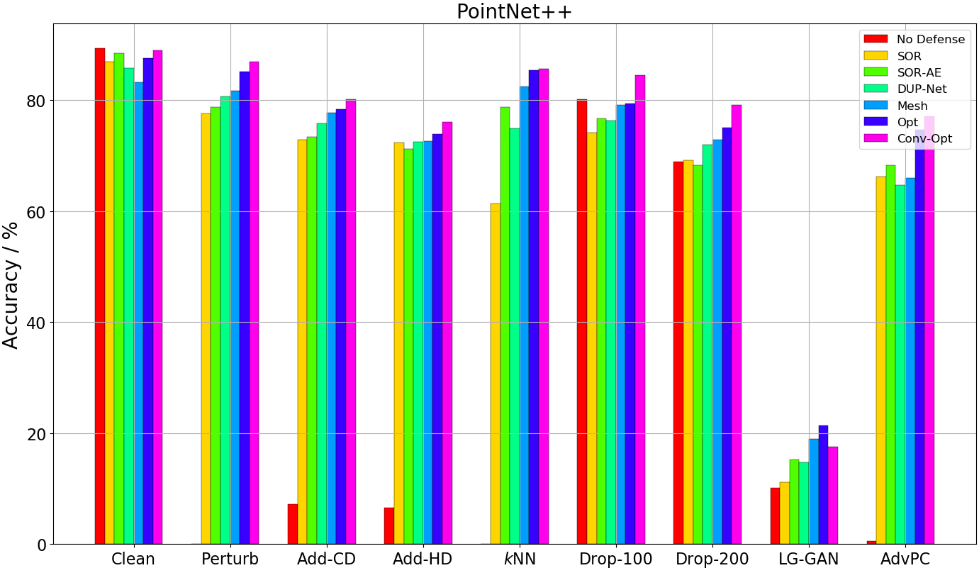
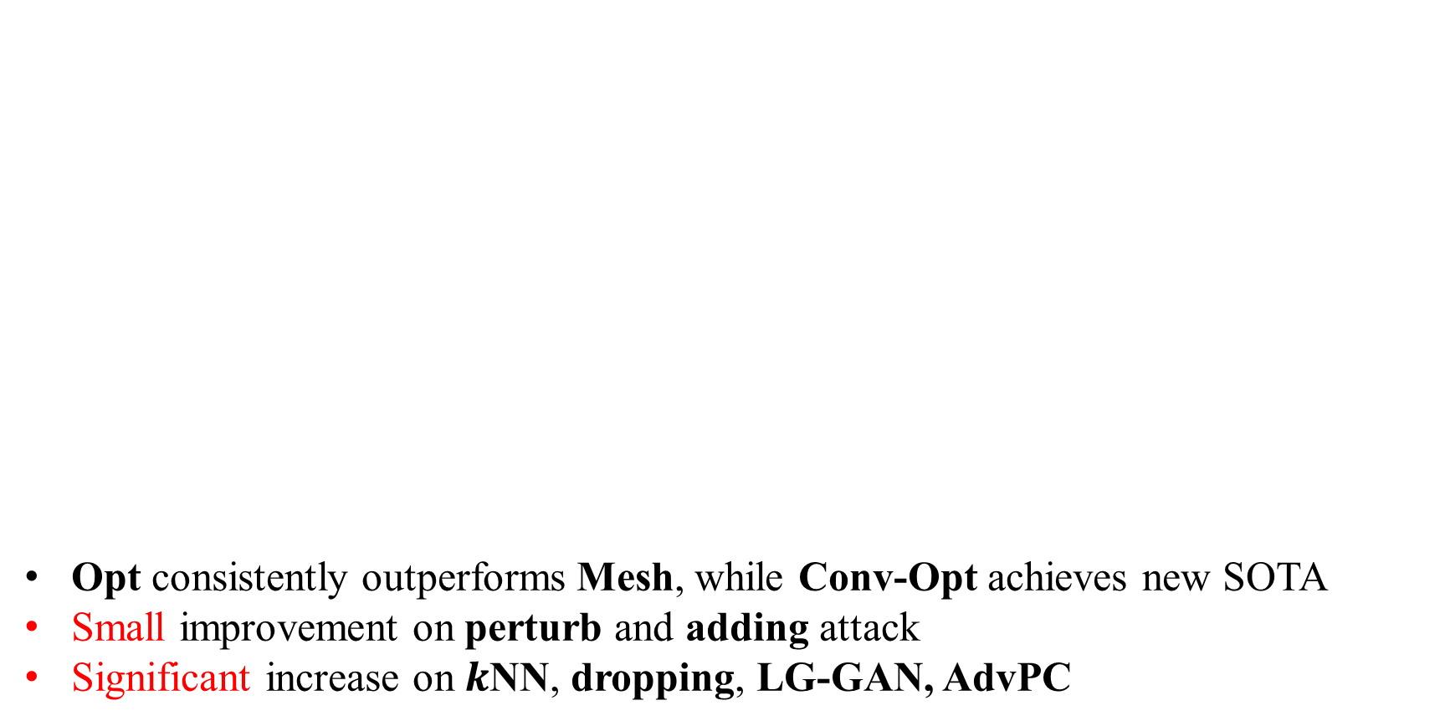
Experimental Results
3.17%
8.77%
Opt consistently outperforms Mesh, while Conv-Opt achieves new SOTA
Small improvement on perturb and adding attack
Significant increase on $k$NN, dropping, LG-GAN, AdvPC
6.64%
6.89%
7.09%
18.88%
13.54%
6.19%
Notes:
I visualize the experimental results using bar charts. Here are two for PN and PN++, the x-axis are different attacks, and y-axis is accuracy after defense, higher is better. The seven color bars are no defense, three previous defense and three variants of IF-Defense. First compare Mesh and Opt, you can see that Opt outperforms Mesh consistently, indicating the effectiveness of the optimization process. Then look at Conv-Opt, it achieves the highest accuracy against most of the attacks, proving that IF-Defense can be further enhanced if combined with stronger implicit function network. Overall, we achieve small improvement on perturbation and adding attack, because SOR can already eliminate the outliers. Besides, we boost the performance significantly on kNN, dropping, LG-GAN and AdvPC attack, because they mainly introduce surface distortion or distribution change, which IF-Defense is designed to address.

Slide 12
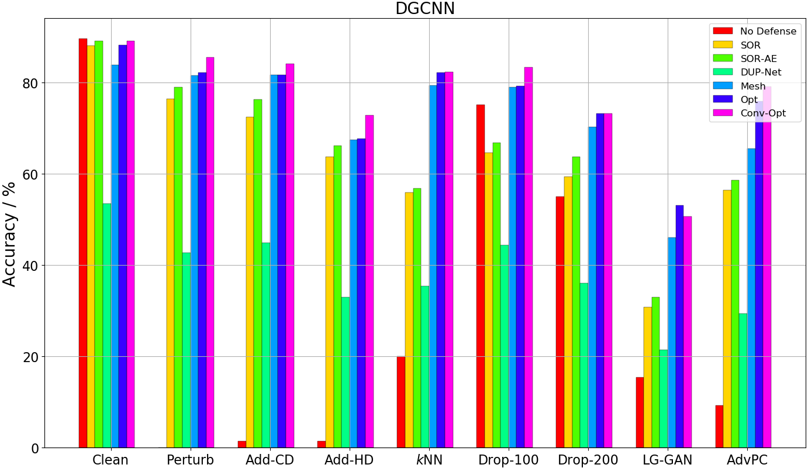
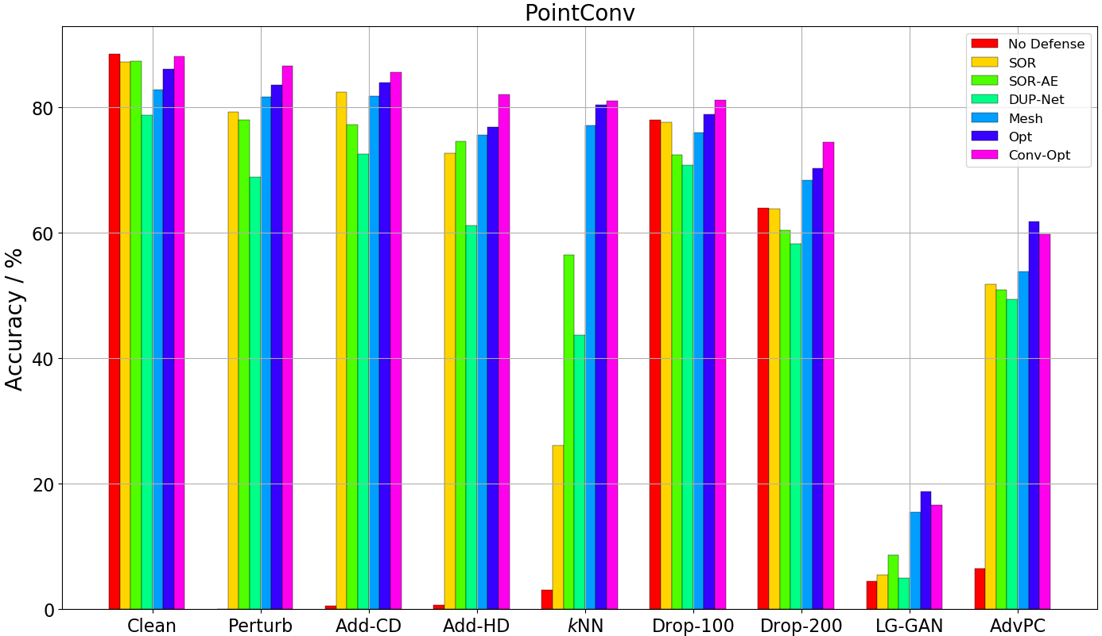
Experimental Results
20.47%
10.02%
Opt consistently outperforms Mesh, while Conv-Opt achieves new SOTA
DUP-Net performs poorly, since it distorts local point distribution
25.55%
24.58%
9.60%
10.73%
20.12%
10.14%
Notes:
We draw similar observations for DGCNN and PointConv. The optimization based IF-Defense still outperforms the re-meshing based counterpart, and Conv-Opt achieves new SOTA in most cases. Interestingly, DUP-Net performs poorly on these two models. We conjecture that this is because DGCNN and PointConv build local kNN graphs and propagate information through the graphs, thus being sensitive to local point distribution. On the other hand, DUP-Net upsamples points and significantly increase the local density, so it greatly affects the kNN graphs. But such problem doesn’t exist in our method, we optimize towards desired distribution and can have arbitrary number of output points. Consequently, we even boost the accuracy for more than 20% in some cases.

Slide 13
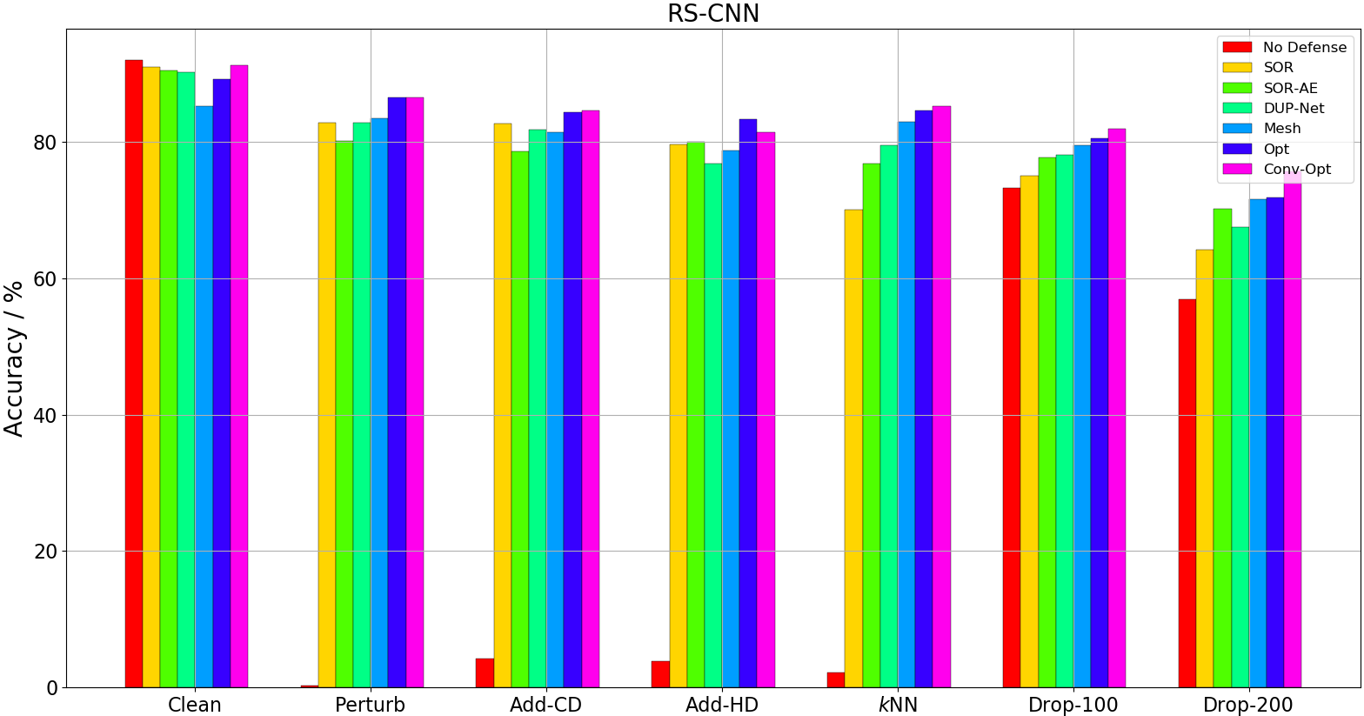
Experimental Results
IF-Defense still achieves the highest accuracy against all the attacks
Interestingly, DUP-Net performs fairly well here
RS-CNN inputs the distance between points, thus modeling the point distribution
5.79%
5.42%
Notes:
Finally for RS-CNN, we only test six attacks and again improve all the defense accuracy. Interestingly, although RS-CNN is also a convolution based method, DUP-Net performs fairly well here compared to on PointConv. This might because RS-CNN explicitly leverages the Euclidean distance between points as input features for the local graphs, and thus can model the point distribution. As a result, it’s less sensitive to point density change introduced by DUP-Net.

Slide 14
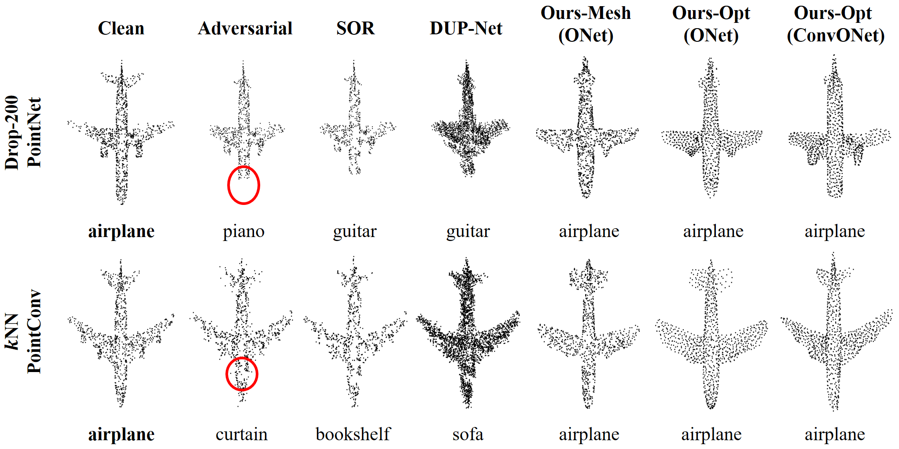
Qualitative Results
Notes:
Here are some qualitative results. Each row is one attack and each column is one defense.
For point dropping attack, the head of the airplane is discarded, and all three variants of IF-Defense extend the front end trying to form a head.
For kNN attack, you can see that SOR causes a hole here after removing outliers, and DUP-Net outputs a point cloud with messy point distribution. In contrast, all three variants of IF-Defense retain clean shape and desired point distribution, so they’re correctly classified by the victim model.

Slide 15
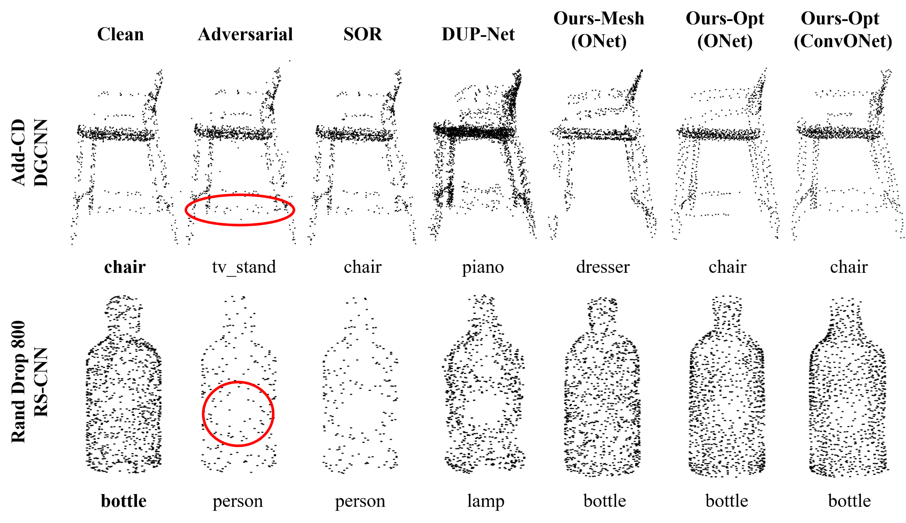
Qualitative Results
Notes:
And more visualizations in this page. For point adding attack. The re-meshing based IF-Defense fails to capture the chair’s leg and its connection part, while the optimization based IF-Defense succeed.
And this row is the result of sparse point cloud. The setting is that I randomly drop 800 points from the original 1024 points, and then test the model accuracy on the remaining sparse points. I don’t show the numerical results in this slide but you can refer to my paper if you’re interested. Because of the encoded priors and strong representation capacity of the implicit function networks, our IF-Defense can perform shape completion with only 200 points, and preserve its semantic information.

Slide 16
Rethinking: Why Implicit Function?
We need shape priors to recover surface distortion – the reconstruction models
Explicit representations:
Point cloud: cannot control point distribution
Voxel/Mesh: errors in reconstruction results
Implicit representations:
Can leverage inputs to compensate reconstruction errors
Can optimize towards desired point distribution
The point cloud restoration process is non-differentiable
Notes:
It seems that I still have some time, and I want to clarify one point. Well, I have talked about this project with my friends and colleagues and a frequently asked question is why I use implicit function, why is it suitable for point cloud adv defense. I think I can discuss our motivation here. First of all, there is an aspect of attack effect called surface distortion which is not considered by previous methods, and we need shape priors to recover it. So a natural way is by leveraging the 3D reconstruction models, because they capture the clean shape manifold after pretraining. Then think about the output representation of the reconstruction model, there are two choices, explicit and implicit. If we use explicit representation, for example a point cloud autoencoder that directly outputs points, we can’t control the generated point distribution. If you still remember one of the baseline defense called SOR-AE, although it can also project the input shape to the clean shape manifold, it performs worse than IF-Defense because of the bad point distribution. Besides, if we use mesh or voxel based representation, it’s true that we can sample points from them using desired sampling pattern, but the errors in the reconstruction will degrade the defense performance.
In contrast, if we use implicit representations such as implicit function networks, we can solve the above issues. We can leverage the information contained in the input to compensate the errors in the reconstruction, and optimize towards desired point distribution. Additionally, this optimization process is non-differentiable, thus making it difficult to attack by white-box methods.

Slide 17
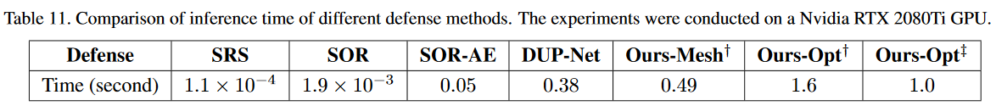
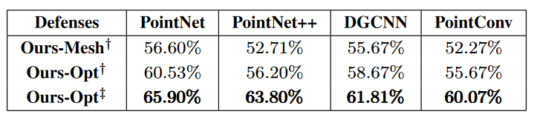
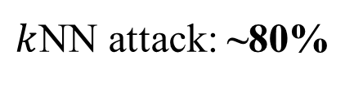
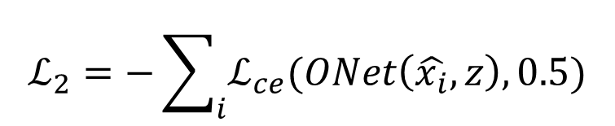
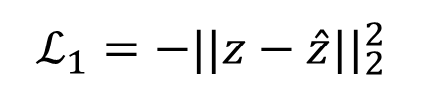
More Experiments
Inference Time
Adaptive Attack
White-box attack targeting on IF-Defense
The optimization process is non-differentiable, so attack the implicit field
Accuracy still higher than 50%
The encoder-decoder structure
$$ℒ_{2}=−\sum_{i}{ℒ_{ce}(ONet\left(\hat{x_{i}}, z\right),0.5)}$$
$$ℒ_{1}=−||z−\hat{z}||_{2}^{2}$$
$k$NN attack: ~80%
Notes:
Here I present some extra experimental results. First is about the inference speed of different defense methods, which is crucial in real world deployment. I show the inference time in this table. Because of the optimization process, Opt and Conv-Opt are more time-consuming than previous methods. This is a big drawback of IF-Defense. But still, Conv-Opt reduces the inference time by ~40% compared to Opt, since ConvONet is more efficient and lightweight than ONet, indicating that IF-Defense can be further accelerated when combined more efficient implicit function network. Besides, we can leverage batch processing for offline applications. Overall, I think improving the speed of defense is a future direction.
Another experiment is about adaptive attack. In the adv ML community, there is a principle that, it’s not sufficient to evaluate a proposed defense only on existing attacks. instead, we need to design an adaptive attack that targets on the proposed defense specifically, where the attacker is assumed to have full knowledge of the defense. As mentioned before, the optimization process that re-generates points from the implicit field is non-differentiable, blocking the gradient for a white-box attack, so we instead attack the implicit field. We design two loss, the first one is to distort the shape code z extracted by the encoder, the second one is to perturb the points off the surface, just recall that 0.5 is the GT probability for the object boundary. We optimize these two loss to generate adv point clouds. In order to compare adaptive attack with previous attacks, we constrain the Chamfer distance between clean and adv point clouds to be similar to the kNN attacks and follow its settings such as attack iterations. Here are the results, although the adaptive attack degrades the performance more significantly than previous attacks such as kNN attack, it’s still higher than 50%, which is an acceptable worst-case accuracy. We hypothesize that this is still because of the shape priors encoded in the decoder of the implicit function network. Even if the attack distorts the shape code, the decoder can still somehow mitigate the distortion by projecting it back to the clean shape manifold. So I think it would be an interesting future direction to study how to differentiate through the optimization process and break IF-Defense.

Slide 18
Summary
Comprehensive study of the effects of existing 3D adv attacks
Propose a general defense framework IF-Defense to tackle all attack effects
Introduce an optimization based method for point cloud restoration
Achieve new SOTA defense performance against all the attacks on five typical point cloud networks
Paper submitted to CVPR’21
Notes:
Finally let me do a summary here. In this project, we first conduct a comprehensive study of the effects of existing 3D adv attacks. Then, we analyze shortcomings of previous defense and propose a general framework named IF-Defense to simultaneously address all of them. Additionally, in order to alleviate the errors in the implicit fields output by the network, we introduce an optimization based method to restore points directly from the implicit representation. Finally, we achieve new SOTA defense performance against all the attacks on five typical point cloud networks. Based on this work, a paper is submitted to CVPR’21, of which I am the first author.

Slide 19
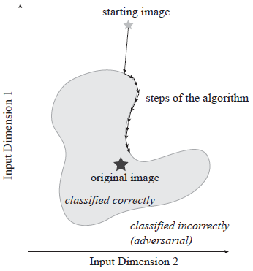
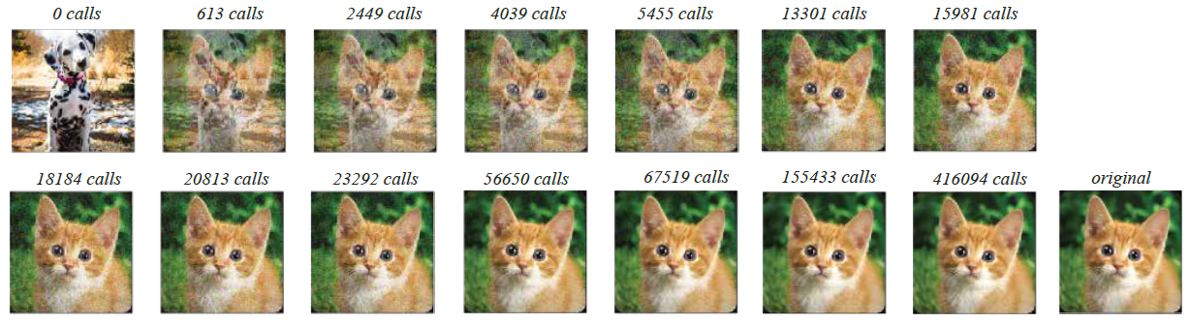
Future Works
Try more point cloud networks, e.g. submanifold-/sparse-convolution
Explore black-box attack in 3D point cloud (on going)
2D black-box attacks rely on exhaustive search
3D attacks have more choices
No clear point correspondence
Find salient points/semantic parts to reduce search space?
[1] Brendel, Wieland, Jonas Rauber, and Matthias Bethge. "Decision-based adversarial attacks: Reliable attacks against black-box machine learning models." ICLR 2018.
Notes:
About future directions, first I think we can test some other networks like the submanifold or sparse convolution models, for example the Minkovski convolution. These modules are commonly used in point cloud detection and segmentation tasks.
Also, I’m currently doing a project studying the black-box attack in point cloud, where we want to attack the model without knowledge of its architecture and parameters. This is a more practical settings in reality. In 2D black-box attack, the attackers mainly rely on changing the pixel values and exhaustive search. This is a very famous method called Boundary attack. Assume we want to attack a cat image to let the model predict dog for it. We first initialize from a dog, and then go to the model’s decision boundary between cat and dog, and move along the boundary to find the best location that has the least perturbation under some measurements. But there are many problems if we directly apply this method to 3D. First, 3D attacks can perform perturbation as well as adding and dropping, it’s unclear how to incorporate adding and dropping in this framework. Secondly, since point clouds are unordered data, there is no clear correspondence between two point sets. This poses difficulty on searching. I have tried applying some 2D black-box attack on 3D, and find them very time-consuming.
To accelerate the attack, I think we can borrow ideas from 2D subspace attack. We can identify salient or semantically meaningful parts of a point cloud, and constrain the attacks in these regions. For example the head of a car or the wing of an airplane. I’m having some progress in this direction so far.

Slide 20
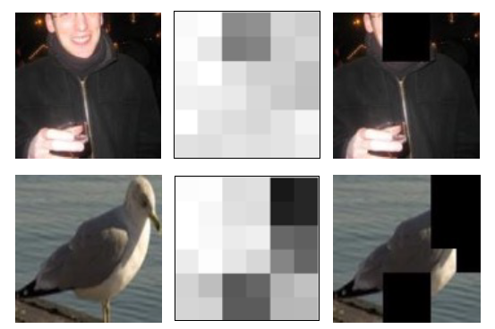
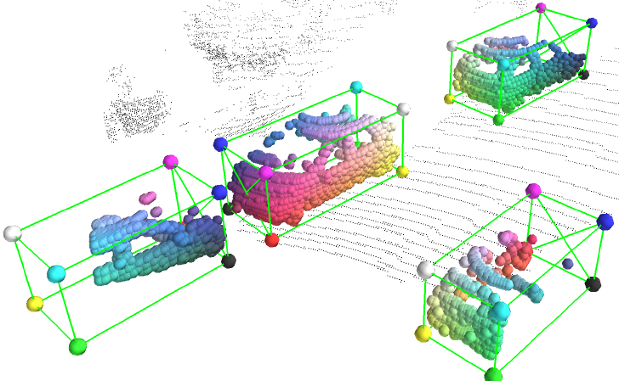
Future Works
Extend to more tasks, e.g. 3D object detection, scene segmentation
Similar work in 2D detection: A-Fast-RCNN (CVPR’17)
Improve detector robustness using adv examples
Generate occlusion masks to make objects harder to detect
However, the resulting images look unnatural, may harm the model
Occlusions/noises in 3D LiDAR point clouds are common and natural
[1] Wang, Xiaolong, Abhinav Shrivastava, and Abhinav Gupta. "A-fast-rcnn: Hard positive generation via adversary for object detection." CVPR 2017.
Notes:
Another possible direction is that, we can leverage adversarial training to improve LiDAR detector’s robustness against occlusions. There are similar works in the 2D image domain. For example, the A-Fast-RCNN published on CVPR 2017. They propose to improve the model’s robustness using adversarial examples. Concretely, they generate occlusion masks to make the objects harder to detect. But the question is, these adv images look unrealistic, which can harm the model training.
But in 3D, the occlusions and noises are very common in the LiDAR point clouds. As shown here, the cars are bounded by the green boxes, you can see that we only have partial observations of them because of occlusions. So I think we can generate adv examples to make LiDAR point cloud detectors more robust. Actually your group have a CVPR 2020 paper about physically realizable adversarial examples for LiDAR object detectors, which shows promising results by training on adv objects. I think we can further extend it to other issues such as occlusions and noises.
Overall, I think there are still many to be explored in the 3D robustness topic. And that’s all for my talk today. Thank you for listening! Are there any questions?

